Slide 1

A project presentation
on
Verilog Implementation of
8-Bit Ternary Multiplier
Presented by
J.Narasimha Rao
Gyanendra Vimal
Hardik Garg
Presented to
Dr. Sanjeev Rai
DEPARTMENT OF ELECTRONICS AND COMMUNICATION ENGINEERING
MOTILAL NEHRU NATIONAL INSTITUTE OF TECHNOLOGY
ALLAHABAD-211004, INDIA

Slide 2
Contents
Introduction
Design Workflow
About Ternary Logic
Ternary logic ?
Ternary Inverter
Design of Ternary Half Adder
Algorithm Used
Simulation and Results
Why Ternary Logic ?
Conclusion
Future Scope
References

Slide 3
Introduction
A 8-bit Ternary Multiplier is a device which performs multiplication operation between two ternary numbers.
Multipliers play a very important role in today’s Digital signal processing and various applications.
With advances in technology, many researchers are trying to design multipliers which offer – high speed, low power consumption, less area. Making them suitable for various high speed, low power and compact VLSI implementation.
The performance of multiplier is determined by the number of partial products that needs to be added. As the number of partial products that is added reduced the multiplier produces a better performance.

Slide 4
Design Workflow
Designing of Ternary Parallel adder with full adder using Verilog
Designing of Ternary Complementor module using Verilog.
Integration of the parallel adder and complementor modules in Verilog to complete design of multiplicative algorithm.
Preparation of the Test Bench to verify the working of 8-bit Ternary Multiplier. (Functional Verification)

Slide 5
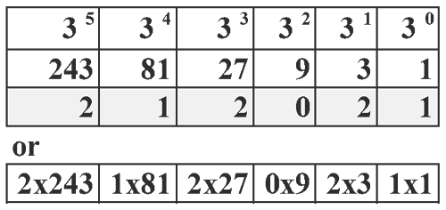
Ternary logic ?
Ternary logic is 3-valued switching digital system.Three different symbols 0,1,2 are used to represent ternary number system.In ternary system the term trit is used to represent ternary digit.
For supply voltage of 5 v, 3 levels of ternary system are defined as:
logic 0 = ground potential, logic 1 as 2.5V and logic 2 as 5v.
The decimal value 628 is expressed in ternary as 212021

Slide 6
Ternary Inverter
Ternary Inverter is a basic ternary gates, which is used for constructing ternary AND/NAND, ternary OR/NOR etc which are the basic building blocks of any ternary circuits.
The implementation of ternary inverters requires three inverters: negative ternary inverter (NTI), standard ternary inverter (STI), and positive ternary inverter (PTI).
STI circuit is the same as a conventional CMOS inverter, except that the transistors have been replaced by QDGFETs.
Inverter Truth Table
Input | STI | PTI | NTI
0 | 2 | 2 | 2
1 | 1 | 2 | 0
2 | 0 | 0 | 0

Slide 7
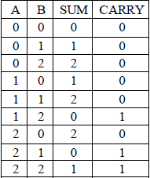
Design of Ternary Half Adder
A ternary half adder adds two ternary numbers and generates ternary sum bits and carry bits.
Half Adder is used in building full adder which is building block of parallel adder.
Half Adder Truth Table.

Slide 8
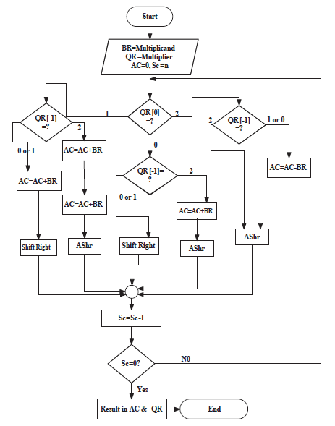
Algorithm Used

Slide 9
A ternary number with a stream of 2 can be expressed as 3m+1 − 3k where k is the starting position of 2 and m is the ending position of 2 and counting is start from number 0.As for example 2220 = 34 − 31.and 2221 = 34 − 31 + 1.2022 = 34−33+32−30.2122 = 34−33+32×1+32−30.If the number contain only 0 and 1 as symbols then we take the usual expression; Arithmetic left shift of a number is three times the number. So at the time of multiplication if the multiplier contains stream of 2s we simply Arithmetically left shift the multiplicand.
The multiplication algorithm is based on the following rules
1) if QR[0]QR[−1] = 22 then partial product is arithmetically right shifted.
2) QR[0]QR[−1] = 20 or 21 then multiplicand is subtracted from from the partial product followed by AShr.
3) QR[0]QR[−1] = 00 or 01 then the partial product is simply right shifted.
4) QR[0]QR[−1] = 02 then multiplicand is added with the partial product followed by AShr.
5) QR[0]QR[−1] = 10 or 11 then multiplicand is added with the partial product followed by simple right shift.
6) QR[0]QR[−1] = 12 then multiplicand is added twice to the partial product arithmetic right shift.

Slide 10
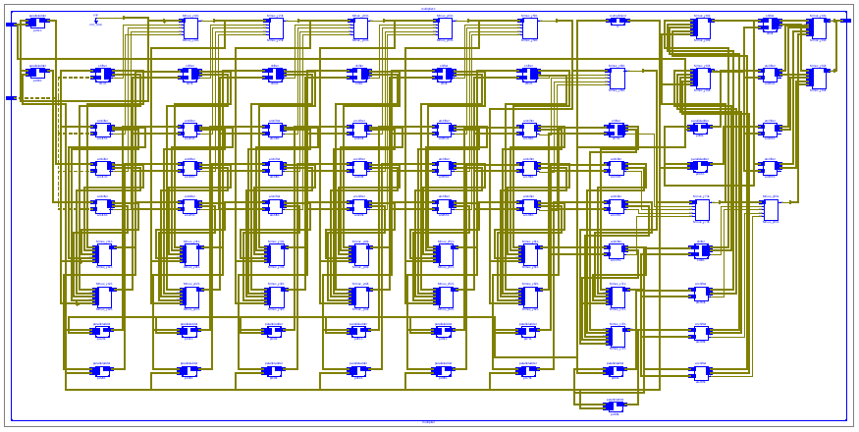
Simulation and Results
8-bit Ternary Multiplier has been synthesized using the Xilinx ISE design suite 14.7 and the simulation results are shown below in figures respectively:
Ternary Multiplier RTL Schematic of Top Module

Slide 11


Multiplication result for different inputs:
0: logic 0(low level); Z: logic 1(intermediate level); 1: logic 2(high level)
input 1 : 22220000(base 3) = 6480(base 10)
input 2 : 20202020(base 3) = 4920(base 10)
output : 4920*6480 = 31,881,600(base 10) = 2012222202100000(base 3)
input 1 : 21212121(base 3) = 5740(base 10)
input 2 : 20202020(base 3) = 4920(base 10)
output : 4920*6480 = 28,240,800(base 10) = 1222010210002120(base 3)

Slide 12
Why Ternary Logic ?
Among all MVL systems ternary logic has some advantages as given below
1. Since 3 is the smallest radix higher than binary, ternary functions and circuits have the simpler form and construction. They can be studied and discussed easily, yet they still display the characteristics of multivalued elements.
2. Since 3 is the digit nearest to e = 2.718, ternary circuits will be more economical according to this measure.
3. Since 3 is not an integral power of 2, research on ternary logic may disclose design techniques that are overlooked in the study of binary or quaternary logic.

Slide 13
Conclusion
A design scheme for Ternary Multiplication, it’s implementation and verification has been presented here.
8-bit Ternary Multiplier using verilog HDL on Xilinx ISE 14.7 software and ISIM was used for simulation.
A complete software based model for designing of Ternary Multiplier has been done. After carrying out the Register Transfer Level modelling, implementation (i.e. functional verification) is done using test bench parameters and results viewed using ISIM simulator environment.

Slide 14
Future Scope
For future development, after carrying out the Register Transfer Level modelling, the functional model can be implemented using QDGFET Inverters as the basic building blocks.
Developing a synthesis tool that supports ternary logic. The existing FPGA and CPLD are compatible with binary logic. Availability of synthesis tool supporting ternary logic will provide detail information for the hardwire realization.

Slide 15
References
Subrata Das, Parthasarathi Dasgupta, Samar Sensarma-
“Arithmetic Algorithms for Ternary Number System”
(2012)
Ravi Kishore.A, Sandhya Rani M.H-
“Design of Ternary Logic 8 Bit array multiplier based on QDGFET” (2014)
A.P.Dhande, R.C.Jaiswal, S.S.Dudam-
“Ternary Logic Simulator Using VHDL” (2007)

Slide 16
THANK YOU

